Slide 1

THE ROLLING SCOPES SCHOOL
Networking Workshop: Subnetting Fundamentals
Emil Garipov

Slide 2


Classful Subnetting
When the IP protocol was initially introduced, it was based on a classful addressing structure. This structure offered three distinct network classes, referred to as Class A, B, and C. Each class was associated with a unique subnet mask, determined by the IP range.
Class | 1st Octet Bits | Range | Mask
A | 0 | 0.0.0.0 – 126.255.255.255 | 255.0.0.0
B | 10 | 128.0.0.0 – 191.255.255.255 | 255.255.0.0
C | 110 | 192.0.0.0 – 223.255.255.255 | 255.255.0.0
Classful subnetting downsides:
1. Classful addressing can lead to a lot of wasted IP addresses.
2. Lack of Flexibility: Classful addressing is rigid because it doesn’t allow for subnetting between domains (Inter-Domain).
3. Limited Scalability: As the internet grew, the limitations of classful addressing became more apparent.

Slide 3

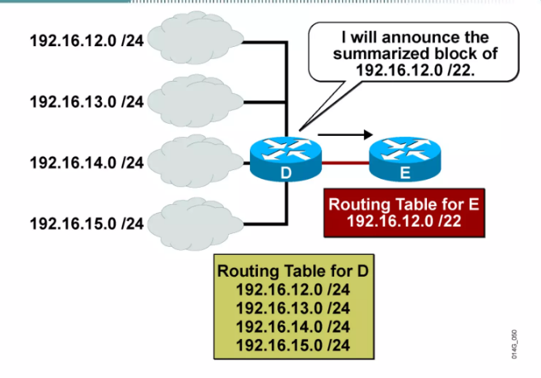
Classless Subnetting
As the internet expanded and the demand for addressing numerous devices intensified, the problem became more complex, necessitating a solution.
Classless addressing lets you use various subnet masks to create subnets that fit the size of each user group or device group. CIDR (Classless Inter-Domain Routing) and VLSM (Variable Length Subnet Masking) are two techniques used to manage IP address space. They are both important for efficiently using IP addresses and reducing the size of routing tables.
CIDR Example
CIDR allows for the aggregation of multiple IP networks into a single network. This is done by using a subnet mask that specifies the number of bits that are used for the network prefix. For example, the subnet mask 255.255.255.0 specifies that the first 24 bits of the IP address are used for the network prefix, and the remaining 8 bits are used for host addresses. This means that the network 192.168.1.0/24 can be aggregated with the network 192.168.2.0/24 into a single network, 192.168.0.0/23.
VLSM allows for the creation of subnets of different sizes. This is done by borrowing bits from the host portion of the IP address.
For example, the subnet 192.168.1.0/24 can be divided into two subnets of 192.168.1.0/25 and 192.168.1.128/25 by borrowing one bit from the host portion of the IP address. This allows for more efficient use of IP address space, as smaller subnets can be created for networks with fewer hosts.

Slide 4

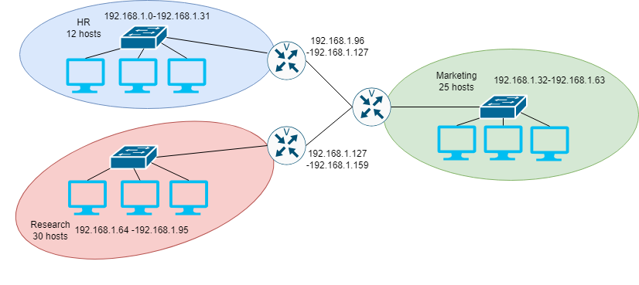
Classful Subnetting Example
You need five subnets, each one containing 30 hosts. The connection between network devices(routers) require only two address each. So, you are wasting 28 usable addresses in each of the router subnet range.
Classful Subnet Range
192.168.1.0 | to | 192.168.1.31 | /27
192.168.1.32 | to | 192.168.1.63 | /27
192.168.1.64 | to | 192.168.1.95 | /27
192.168.1.96 | to | 192.168.1.127 | /27
192.168.1.128 | to | 192.168.1.159 | /27

Slide 5
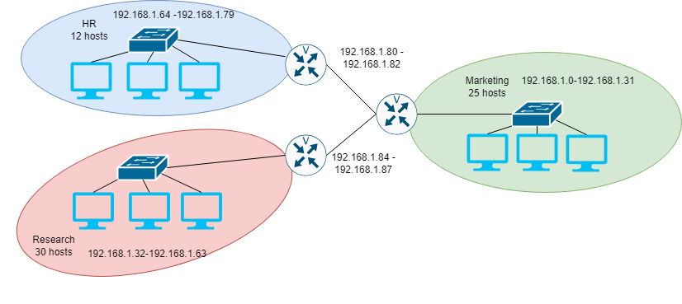
Classless Subnetting Example
You need five subnets, each one containing 30 hosts. The connection between network devices(routers) require only two address each.
Classless Subnet Range
192.168.1.0 | to | 192.168.1.31 | /27
192.168.1.32 | to | 192.168.1.63 | /27
192.168.1.64 | to | 192.168.1.79 | /27
192.168.1.80 | to | 192.168.1.82 | /27
192.168.1.84 | to | 192.168.1.87 | /27

Slide 6
Visualizing subnets using the Box Method
This entire square represents a single subnet, containing 256 addresses.
0 -255
/24
255.255.255.0
256 hosts
1 subnet
Divide the square into two equal parts, resulting in two subnets, each containing 128 addresses.
0-127 | 128-255
/25
255.255.255.128
128 hosts
2 subnet
Divide the square into quarters, resulting in four subnets, each containing 64 addresses.
0-63 | 128-191
64-127 | 192-255
/26
255.255.255.192
64 hosts
4 subnet

Slide 7
Visualizing subnets using the Box Method(continue)
Divide the square into 8 equal parts, resulting in eight subnets, each containing 32 addresses.
0-31 | 32-63 | 128-159 | 160-191
64-95 | 96-127 | 192-223 | 224-255
/27
255.255.255.224
32 hosts
8 subnets
Divide the boxes into half again, resulting in 16 subnets, each containing 16 addresses.
0-15 | 32-47 | 128-143 | 160-175
16-31 | 48-63 | 144-159 | 176-191
64-79 | 96-111 | 192-207 | 224-239
80-95 | 112-127 | 208-223 | 240-255
/28
255.255.255.240
16 hosts
16 subnet

Slide 8
Visualizing subnets using the Box Method(continue)
Divide the square into 8 equal parts, resulting in eight subnets, each containing 32 addresses.
0-31 | 32-63 | 128-159 | 160-191
64-95 | 96-127 | 192-223 | 224-255
/27
255.255.255.224
32 hosts
8 subnets
Divide the boxes into half again, resulting in 16 subnets, each containing 16 addresses.
0-15 | 32-47 | 128-143 | 160-175
16-31 | 48-63 | 144-159 | 176-191
64-79 | 96-111 | 192-207 | 224-239
80-95 | 112-127 | 208-223 | 240-255
/28
255.255.255.240
16 hosts
16 subnet

Slide 9
Task one: Complete the Visualizing subnets using the Box Method
/29
…..
…..
/30
…
…

Slide 10
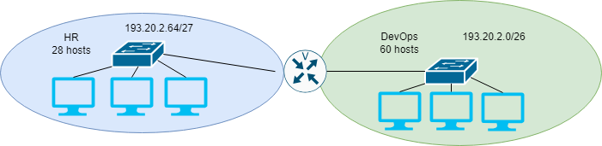
Task two
Based on the provided network topology and information, construct an addressing scheme that employs Variable Length Subnet Masks (VLSM). Represent the subnets in boxes, and use color or shading to indicate the sub-subnets within each box. The business will be utilizing the Class C address 193.20.2.0.
0-63 |  | 128-255
64-95 | 96-127

Slide 11
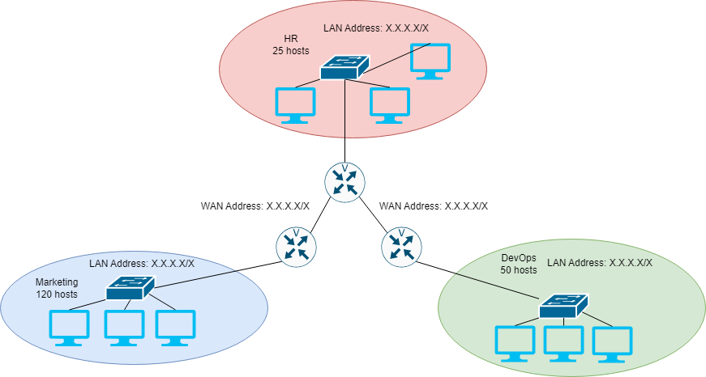
Task three
Based on the provided network topology and information, construct an addressing scheme that employs Variable Length Subnet Masks (VLSM). Represent the subnets in “LAN Address: X.X.X.X/X”, and use color or shading to indicate the sub-subnets within each box. The business will be utilizing the Class C address 223.25.36.0

Slide 12
Task four
You are setting up a network for a company in four locations. Location A has 8 computers. Location B has 122 computers. Location C has 4 computers. Location D has 55 computers. There is a router-router connection between Location C and Location B. Complete the information required below using the class C address 192.168.2.0
Subnet | Subnet Address (x.x.x.x) | Subnet mask(/x)
1
2
3
4

Slide 13

Useful Resources
A Beginners Guide to Subnetting - A Beginners Guide to Subnetting (packetcoders.io)
What is Subnetting? - Subnetting Mastery - What is Subnetting? - Subnetting Mastery - Part 1 of 7 - YouTube

Slide 14


Slide 15

Thank you

